Slide 1
Recursive Computing 只求最优值
取第一个断开位置时计算量
参加运算矩阵链起始位置
矩阵链终止位置
int RecurMatrixChain( int i, int, j, int p[])
{
if ( ) return 0;
int u=RecurMatrixChain(i, i)+RecurMatrixChain(i+1,j,p)
+p[i-1]*p[i]*p[j];
s[i][j]=i;
for(int k=i+1; k<j; k++){
int t=RecurMatrixChain(i,k)+RecurMatrixChain(k+1,j,p)
+p[i-1]*p[i]*p[j];
if (t<u) {
u=t;
s[i][j]=k;}
}
return u;
}
i==j
记录当前断开位置
循环取k的可取断开位置

Slide 2
Step 3. Computing optimal value 保存最优解
void MatrixChain(int p, int n, int * *m, int * *s)
{
for (int i=1; i<=n; i++) m[i][i]= ;//单个矩阵的计算量
for (int r=2; r<=n; r++){//r为每次循环矩阵链的长度
for (int i=1; i<= ; i++)
int j=i+r-1;
m[i][j]= m[i+1][j]+p[i-1]*p[i]*p[j];
s[i][j]=i;
for (int k=i+1; k<j; k++){
int t= m[i][k]+ m[k+1][j]+ ;
if (t< m[i][j]) {
m[i][j]=t;
s[i][j]=k; }
}
}
}
0
n – r + 1
取第一个可取位置，即断开位置为i
循环取k的可取位置
p[i-1]*p[k]*p[j]

Slide 3
Example : there are four items. Bag capacity is 5. w[4]={2, 1, 3, 2}，v[4]={12, 10, 20, 15}. To compute m[1][c] and the solution
j
i
0
1
2
3
4
5
1
37
2
0
10
15
25
30
35
3
0
0
15
20
20
35
4
0
0
15
15
15
15
x₄ X₃ X₂ X₁
m[1][5]>m[2][5]
所以物品1被选
查看m[4][2]>0
1
0
1
1
c – w[1]= 3,查看m[2][3]>m[3][3]
j – w[2]= 2,查看m[3][2]=m[4][2]

Slide 4
Substitution method
The most general method:
1. Guess the form of the solution.
2. Verify by induction.
3. Solve for constants.
Example: T(n) = 4T(n/2) + n
[Assume that T(1) = Θ(1). ]
Guess O(n³) . (Prove O and Ω separately.)
Assume that T(k) ≤ ck³ for k < n .
Prove T(n) ≤ cn³ by induction.

Slide 5
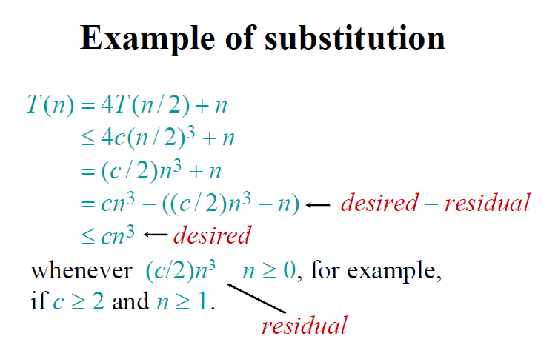

Slide 6
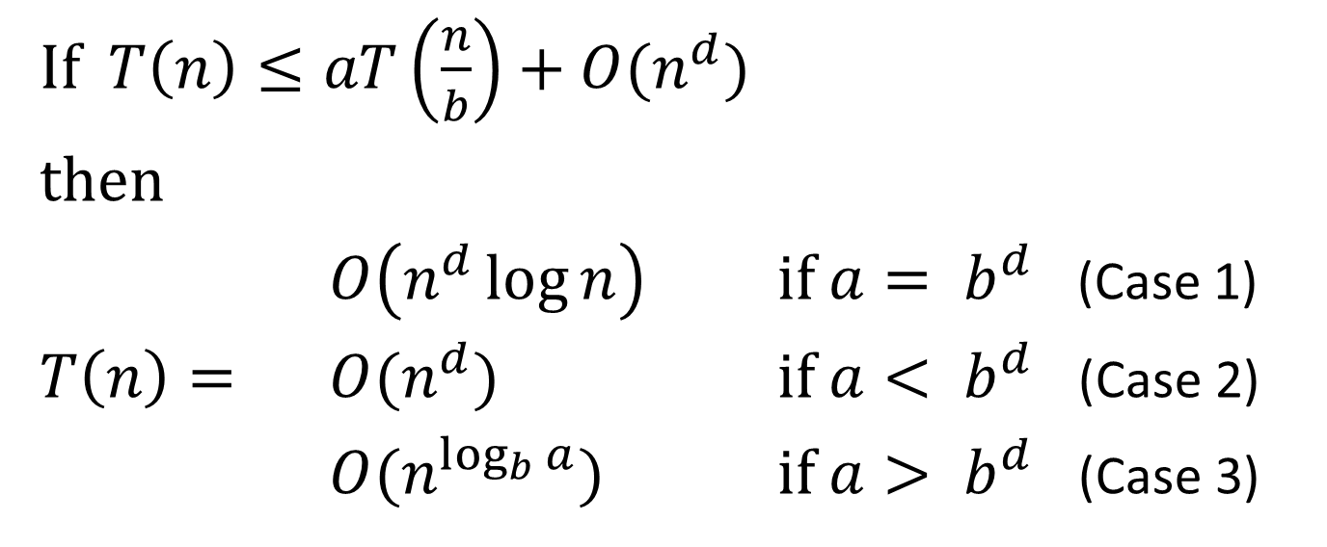
The master method(主方法)
a = number of recursive calls >=1
b = input size shrink factor >1
d = exponent in summing time of combine step >=0

